Slide 1
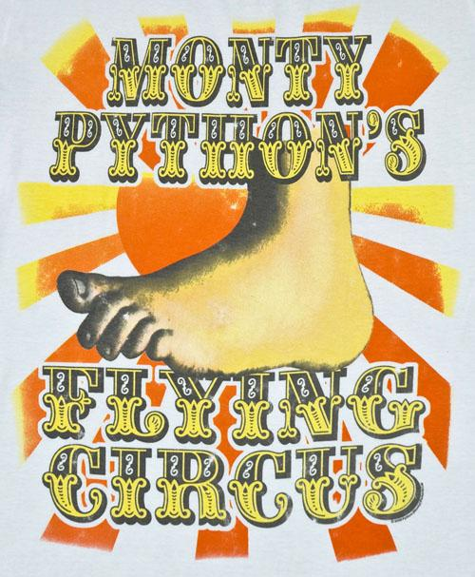
FIT1045: Algorithms and Programming Fundamentals in Python Lecture 2 Introduction to Python
COMMONWEALTH OF AUSTRALIA
Copyright Regulations 1969
WARNING
This material has been reproduced and communicated to you by or on behalf of Monash University pursuant to Part VB of the Copyright Act 1968 (the Act).The material in this communication may be subject to copyright under the Act.Any further reproduction or communication of this material by you may be the subject of copyright protection under the Act.
Do not remove this notice.

Slide 2
Questions left unanswered from last lecture

Slide 3
Objectives of this lecture
To learn a little bit about Python.
To start becoming familiar with Python code.
This matches up with learning outcome 2 (implement problem solving strategies)
Notes:
9/02/2017
3

Slide 4
Where are we?
Using python
Maths in python
Strings
Input/Output
Checkpoint for this week

Slide 5
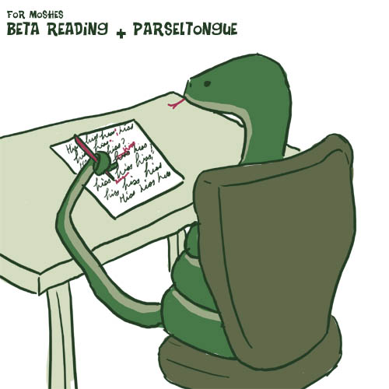
Python
We will use Python to implement the algorithms.
We will use Python to implement the data structures.

Slide 6
Why Python
General purpose
Very popular with many libraries
Very easy to program
Has depth if you need it
Multi-paradigm: OO, functional, and imperative
Associated programming concepts: objects, higher order, etc
Notes:
As long as you do not have to directly access the computer’s hardwarde, you should be fine.

Slide 7
What version of Python?
Python was created by Guido van Rossum in 1990
It is derived from several other languages, e.g. , Algol-68, Modula, C, C++, SmallTalk, etc.
Python 3 was released in 2008
Backward incompatible!
Which one to choose for FIT1045? 2? 3? 2.x? 3.x?
Pros:
Python 3 is a better language
Is the future
Cons:
Less libraries
Not the default in many systems
We go with the future (will be the past once you are working!)
Version 3.3 or 3.5 are the ones we have chosen

Slide 8
Interactive mode
Python can be run interactively.
You can simply type in commands
Python 3.5.1 (v3.5.1:37a07cee5969, Dec 5 2015, 21:12:44)
[GCC 4.2.1 (Apple Inc. build 5666) (dot 3)] on darwin
Type "copyright", "credits" or "license()" for more information.
>>> WARNING: The version of Tcl/Tk (8.5.9) in use may be unstable.
Visit http://www.python.org/download/mac/tcltk/ for current information.
Prompt
>>> 5000*157.5*360/(31.2 - 24)
39375000.00000001
No special character required at the end of lines
Command evaluated

Slide 9
Where are we?
Using python
Maths in python
Strings
Input/Output
Checkpoint for this week

Slide 10
Arithmetic operators
Operation | Description
x + y | Sum
x - y | Difference
x * y | Product
x / y | Division
x // y | Integer division
x % y | Remainder
-x | Negative
abs(x) | Absolute value
x ** y | Power

Slide 11
Operator Precedence https://docs.python.org/3/reference/expressions.html Section 6.16
From Lowest to Highest Precedence. Operators in same row– group left to right
(except for ** that groups right to left)
Operation | Description
+, - | Addition and subtraction
*, /, //, % | Multiplication, Division, Integer Division, Remainder
** | Exponentiation
3+10//3*2**2 = 3+10//3*4= 3+3*4= 3+12=15
2**3**2 = 2**9 = 512
Use parenthesis if not sure, e.g., (2**3)**2 = 8**2 = 64
3*2**3 + 2 = 3*8 + 2 = 24 + 2 = 26

Slide 12
Computing GST
Compute price including GST.
An example:
Price (excluding GST)
$125
GST
$125*10/100=$12.50
Price (including GST)
$125+$12.50=$137.50

Slide 13
Computing GST
Compute price including GST.
Algorithm:
Price (excluding GST)
Price = $125
GST
GST=Price * 10 /100
Price (including GST)
TotalPrice=Price+GST
Output: TotalPrice

Slide 14
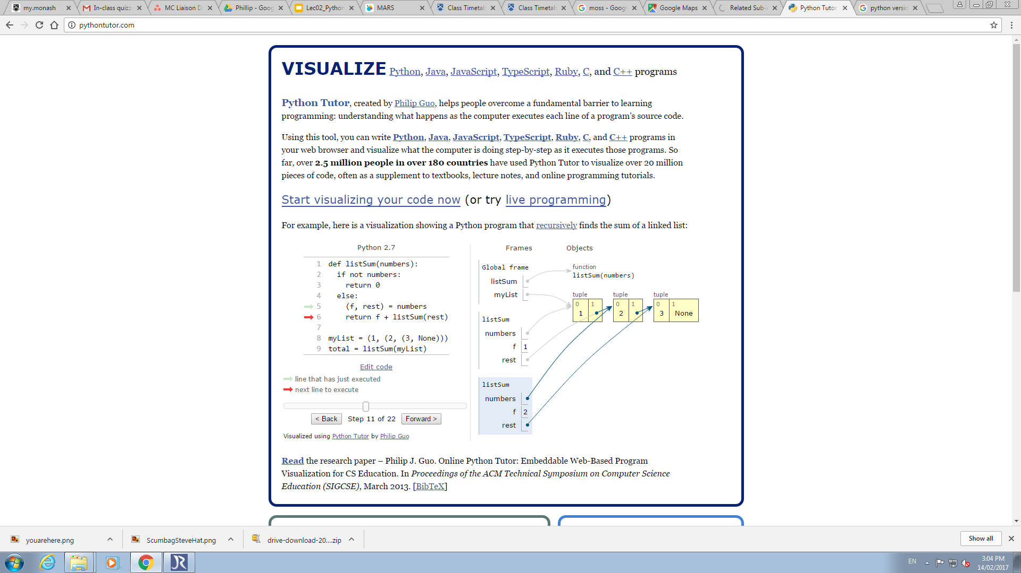
Meet your new best friend

Slide 15
Computing GST
Compute price including GST.
Algorithm:
Price = 125
GST=Price * 10 /100
TotalPrice=Price+GST
Output: TotalPrice

Slide 16

How can you convert AUD$ into Euros?

Slide 17
Currency Convertor
Current value of AUD: E.g. $1 = 0.73 Euro
Amount in AUD: $763.75
Amount in Euros:

Slide 18
Variables
Variables are names for values
Can’t start names with digits, and avoid starting them with underscore.
Names are case sensitive
So price and Price are different variables
Choose meaningful names
No need for the user to declare the type
Python dynamically computes it
Thanks to research on type inference!

Slide 19
Keywords
Do not use the following words as variable names
False | break | else | if | not | try
None | class | except | import | or | while
True | continue | finally | in | pass | with
and | def | for | is | raise | yield
as | del | from | lambda | return
assert | elif | global | nonlocal | str

Slide 20
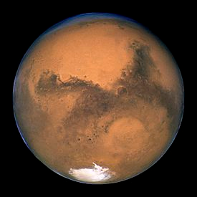
math module
Function or Constant | Description
sqrt(x) | square root
ceil(x) | smallest integer >= x
floor(x) | largest integer <= x
factorial(x) | x!
cos(x) | cosine
sin(x) | sine
tan(x) | tangent
exp(x) | exponential
log(x) | logarithm
pi | 3.141592653589793
e | 2.718281828459045
Must use import
>>> import math
>>> math.sqrt(2)
1.4142135623730951
>>> math.floor(19.7)
19
Must have math before function name

Slide 21
Where are we?
Using python
Maths in python
Strings
Input/Output
Checkpoint for this week

Slide 22
Strings
Python allows to you to work with strings.
Strings in Python are sequences of characters enclosed by quotes.
Some operations work with strings
>>> string = ‘This is a string: enclosed by single quotes’
>>> text = “This is a another string: double quotes work too”
>>> character = ‘e’
>>> ‘hello’ + ‘world’
‘helloworld’
>>> 3* ‘hello’
‘hellohellohello’

Slide 23
String Methods
https://docs.python.org/3/library/stdtypes.html#string-methods
4.7.1. String Methods str.capitalize()
Return a copy of the string with its first character capitalized and the rest lowercased.
str.replace(old, new[, count])
Return a copy of the string with all occurrences of substring old replaced by new. If the optional argument count is given, only the first count occurrences are replaced.

Slide 24
Some string methods
>>> text = ‘a piece of string’
>>> len(text)
17
>>> text.upper()
‘A PIECE OF STRING’
>>> text
‘a piece of string’
>>> text.replace(‘tring’, ‘heet’)
‘a piece of sheet’
>>> text
‘a piece of string’
>>> diffText = 3*text.replace(‘a piece of’, ‘not another’)
>>> diffText
‘not another stringnot another stringnot another string’
>>> diffText.count(‘not’)
6
Note: methods do not change the string
Strings are immutable

Slide 25
Where are we?
Using python
Maths in python
Strings
Input/Output
Checkpoint for this week

Slide 26
Input/Output
Prompt is not required but is recommended
Use input to read in a string
String entered
>>> yourName = input(“Enter your name: “)
Enter your name: superman
>>> print(“Hello “ + yourName.capitalize())
Hello Superman
Prompt
Use print for producing output

Slide 27
Type Conversion
int()
Can convert a string to an integer
float()
Can convert a string to a float
str()
Can convert integers and floats to strings

Slide 28
Input/Output Numbers
This is a string
This converts userNumSqrd
to a string
>>> userNum = input(“Enter a number: “)
Enter your number: 3.14
>>> userNum = float(userNum)
>>> userNumSqrd = userNum*userNum
>>> print(“The square of your number is “ + str(userNumSqrd))
The square of your number is 9.8596
This converts userNum to a floating point number

Slide 29
Where are we?
Using python
Maths in python
Strings
Input/Output
Checkpoint for this week

Slide 30
Where you should be at…
By the end of this week you should be able to do each of the following
Algorithms:
Write an algorithm for open a door
Write an algorithm to change a tyre
Python:
Write a program to add two numbers and print them to the screen
input a decimal number (requesting degrees) and convert this to radians
Print out the cosine of this angle

Slide 31
Help
Some sites:
http://www.python.org
http://www.pythontutor.com/
https://www.codecademy.com/learn/python
Books
“Introduction to Computing using Python: An Application Development Focus”, by L. Perkovic
https://wiki.python.org/moin/BeginnersGuide/NonProgrammers

Slide 32
Recommended Reading
“Introduction to Computing using Python: An Application Development Focus”, by L. Perkovic
Chapter 5

